Slide 1

Source Data Clean-up
List Price Data
Final Cleaned File
County Info | State | Metadata, etc. | 2010-01 | 2010-02 | …
Los Angeles County | CA | Los Angeles-Long Beach-Anaheim | 399000 | 389000 | …
Cook County | IL | Chicago-Naperville-Elgin | 244900 | 249000 | …
Harris County | TX | Houston-The Woodlands-Sugar Land | 149900 | 152900 | …
Maricopa County | AZ | Phoenix-Mesa-Scottsdale | 179900 | 175900 | …
… | … | … | ... | ... | …
Date | Wake County Price | Wake County Sales | Wake County Days | Durham County Price | …
2010-01 | 248000 | 657 | 185 | 178440 | …
2010-02 | 245000 | 713 | 169 | 179900 | …
2010-03 | 239900 | 1108 | 156 | 185000 | …
2010-04 | 239999 | 1376 | 158 | 184900 | …
2010-05 | 244900 | 1400 | 157 | 182000
… | … | … | ... | ... | …
Sales Data
Days before Sale Data
https://www.zillow.com/research/data/
Notes:
Select for NC counties
Eliminate metadata columns
Merge 3 data sets into one on county name
Add data type to each county column header
Transpose rows and columns

Slide 2
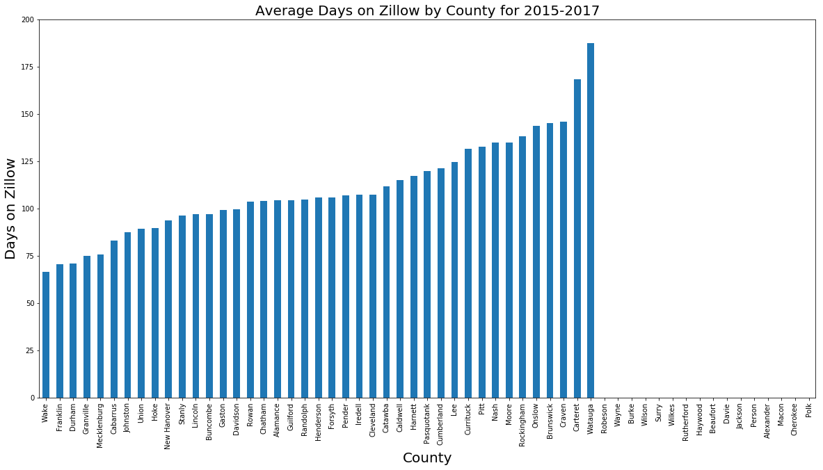

Slide 3
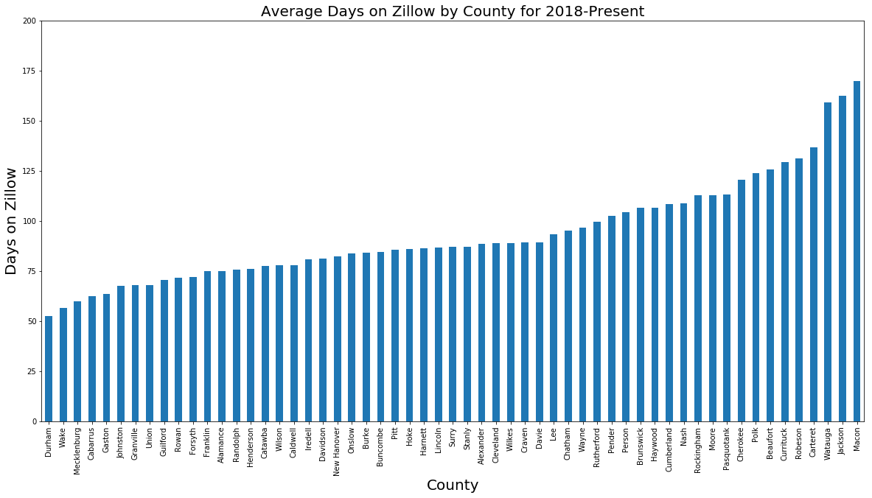

Slide 4
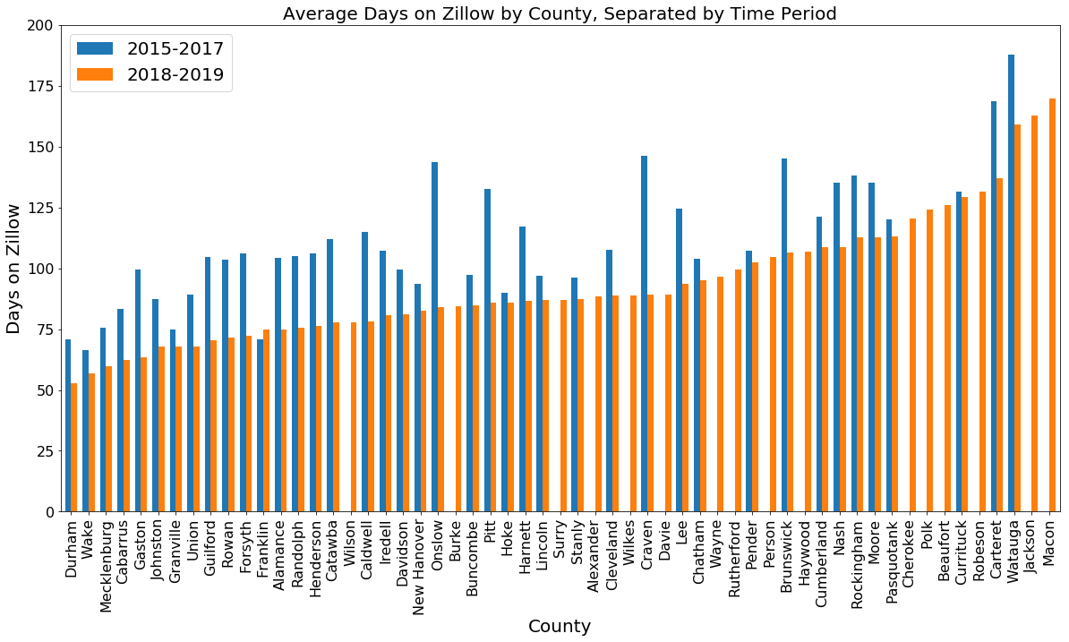

Slide 5
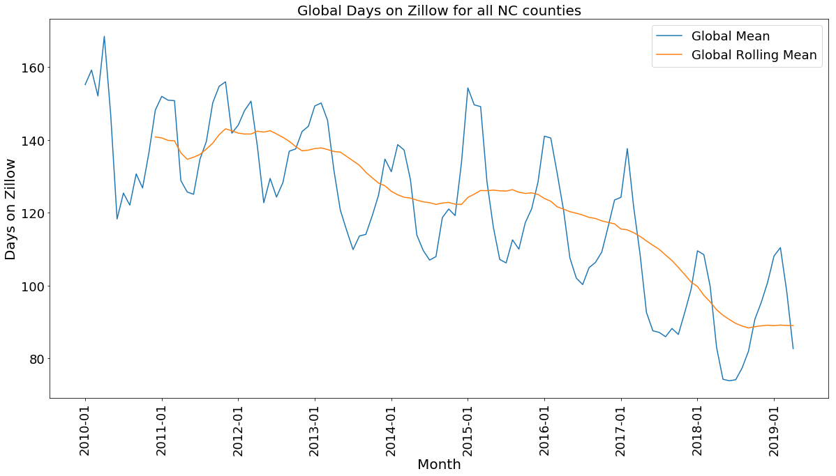

Slide 6
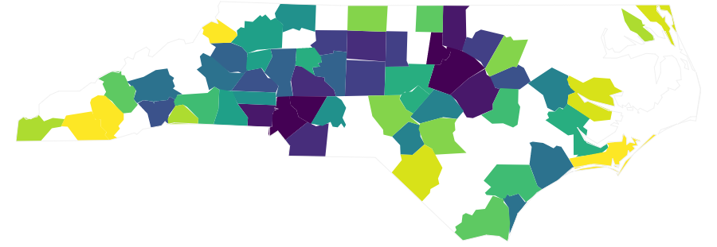
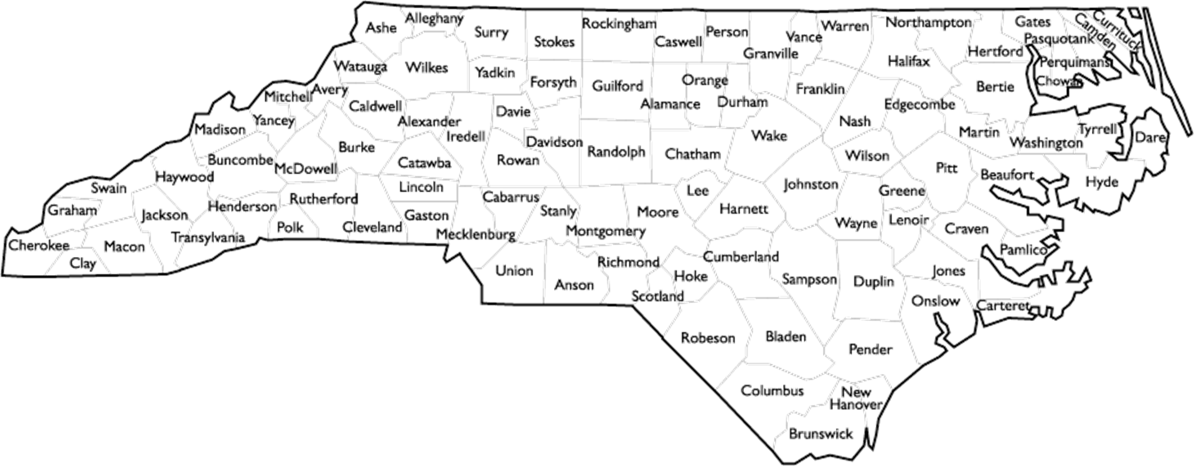
Average Days on Zillow for NC Counties (2018-Present)
Lowest Number of Days
Highest Number of Days

Slide 7
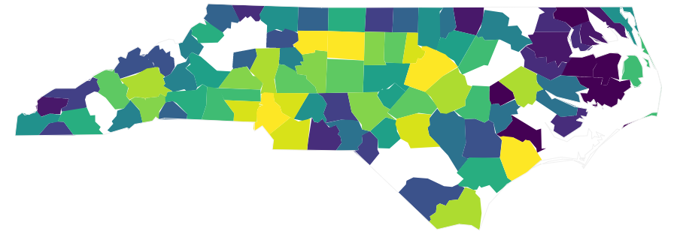
Average Sales on Zillow for NC Counties (2018-Present)
Lowest Sales
Highest Sales

Slide 8
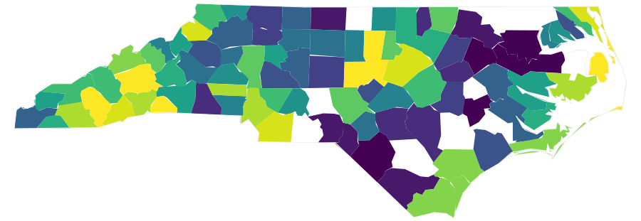
Average Price on Zillow for NC Counties (2018-Present)
Lowest Price
Highest Price

